Slide 1
Facility Reservations
2013/2014 Facilities Use

Slide 2
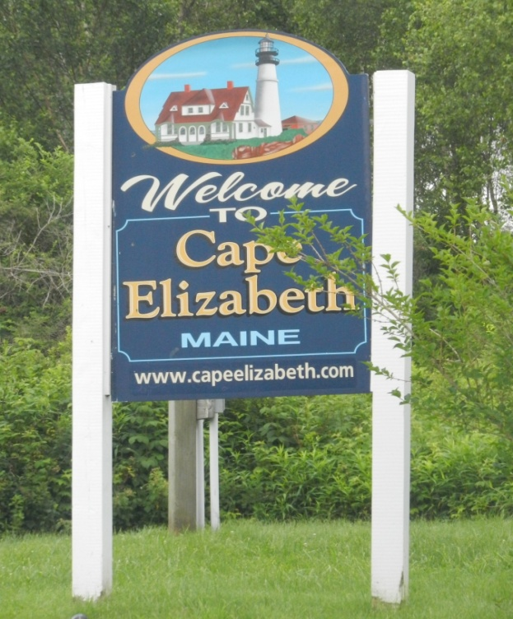
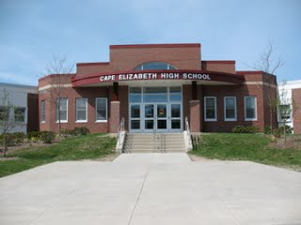
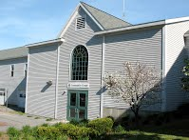
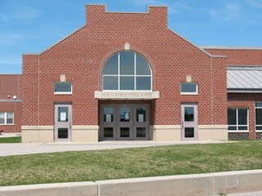

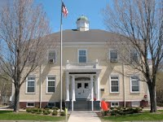
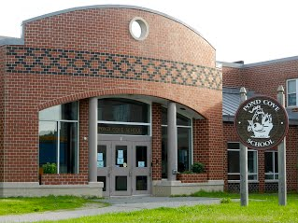
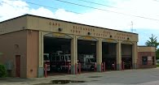

Slide 3
The Numbers
Total reservation September 2013 – July 2014
            8491 reservations
            771 monthly average reservations
            March 2014 951 reservations
Reservations locations:
Community Services Total reservations *3204
High School Total reservations *2549
Middle School Total reservations *881
Pond Cove Total reservations *632
Thomas Memorial Library Total reservations *417
Town Center Fire station Total reservations *49
Town Hall Total reservations *759
* 11 month period. Internal and external reservations

Slide 4
Facility Use updates
Annual Site supervisor training
Flexible rate schedules
Online Facility requests (www.capeftd.org)
Facility Use Committee annual review team
    Committee members:
          Nikki Dresser, Citizen
          Caroline Flaherty, Citizen
          Peter Gleeson, Fire Chief
          Janet Hoskin, Facilities Scheduler
          Meredith Nadeau, Superintendent of Schools
          Jay Scherma, Library Director
          Jeff Shedd, High School Principal
          Jessica Sullivan, Town Council Chair
          Jeff Thoreck, Athletic Director
          Katie Williams-Hewitt, School Board Member
          Mike O’Connor, Citizen

Slide 5
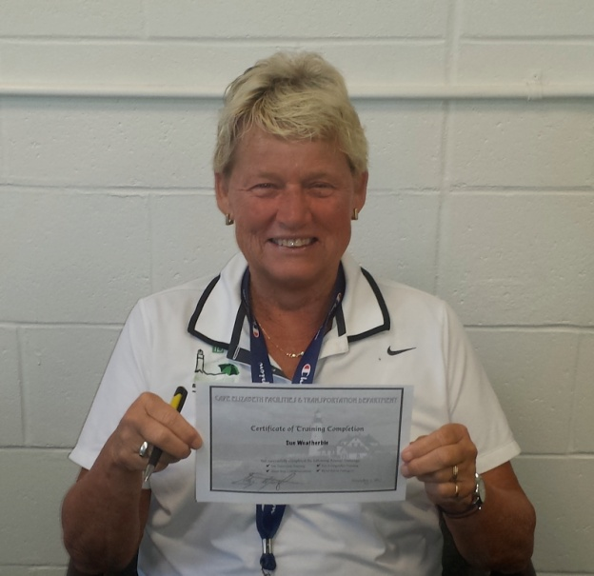
Site Supervisor training
Different types of Site Supervisors
          Paid Site Supervisor
          Program Volunteer Site Supervisor
Annual required training
          36 people have attended annual training
          12 people have attended annual refresher training
          Over 50% are volunteer Site Supervisors

Slide 6
Flexible rate schedules
Cape Elizabeth resident groups pay no fees
          Cape Elizabeth Little League
          Cape Elizabeth Education Foundation
          Cape Elizabeth Historical Society
          Broad Cove Neighborhood
Flexible rates for multi booking users
          Coastal Maine Aquatics
          First Evangelical Church
Larger group booking
          Maine Senior Games
          East Cobb Baseball Tournament

